Slide 1
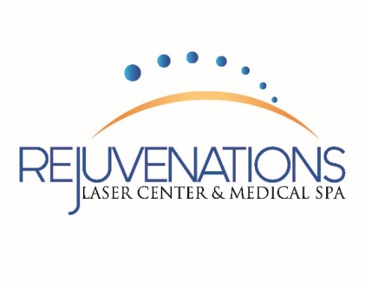
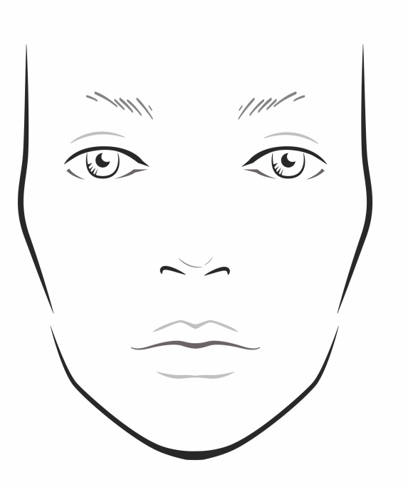
What Treatment Do I Need?
Forehead Lines/Frown Lines
Neurotoxin
Pearl® Fractional
Microneedling
Genius®
Crows Feet
Neurotoxin
Laser Genesis®
Venus Legacy® & Venus Viva®
Pearl® Fractional
Texture of Skin/Pore Size
Pearl® Fractional
Skinvive®
Laser Genesis®
IPL/Limelight
Microneedling
HydraFacial ®
Chemical Peels
Microdermabrasion
Under Eye Circles/Fine Lines
Venus Legacy® & Venus Viva®
Laser Genesis®
Pearl® Fractional
Vein Therapy
Chemical Peels
TIXEL™
Brown Spots/Discoloration
Limelight
Excel V® Treatment
Pico Genesis®
Chemical Peels
Pearl® Resurfacing
TIXEL ™
Facial Volume Loss
Dermal Fillers
Pearl Fractional
Lips – Volume Loss
Dermal Fillers
Laser Genesis
Broken Blood Vessels/Redness
Laser Vein Therapy
IPL/Limelight
Excel V® Treatment
Lip Lines/Wrinkles
Dermal Fillers
Skinvive®
Neurotoxin
Permanent Makeup
Pearl® Fractional
Microneedling
Laser Genesis®
Venus Viva®
Genius®
TIXEL™
Unwanted Hair
Laser Hair Removal
Dermaplane
Face - Skin Tightening
Venus Legacy® & Venus Viva®
Titan®
Genius®
Fat Reduction or
BodyContouring
EMSCULPT® NEO
Venus Legacy®
Coolsculpt®
Kybella®
Neck/Chest - Skin Tightening/Wrinkles
Microneedling
Venus Legacy® & Venus Viva®
Laser Genesis®
Pearl® Resurfacing
Genius ®
TIXEL ™
Neck/Chest Discoloration
IPL/Limelight
Excel V® Sundamage Treatment
Pearl® Resurfacing
Skin Hydration
Skinvive

