Slide 1
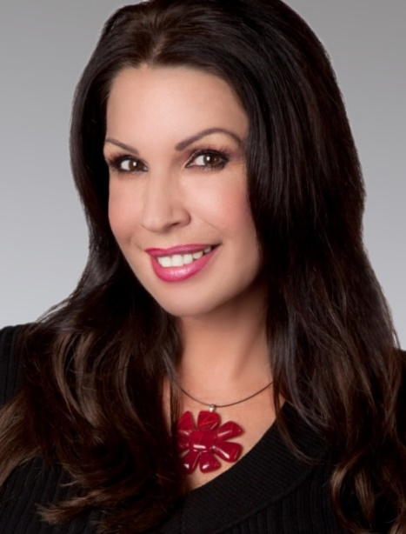


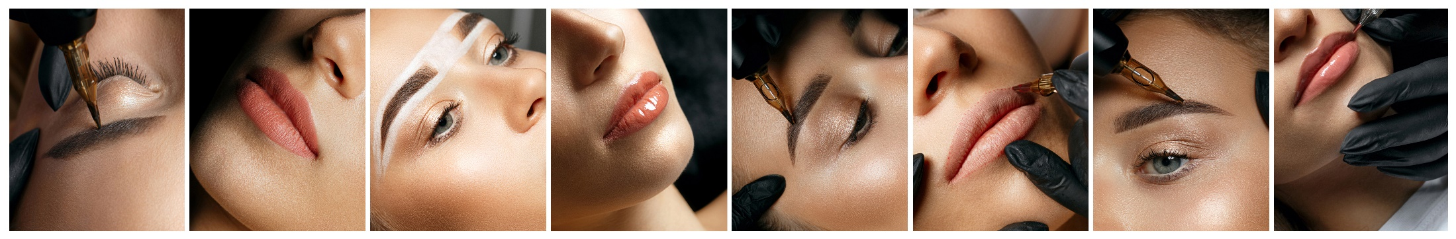
Nov 2nd, 2023
Open House
TOP & BOTTOM EYELINER
Only $550! Normally $650
TOP EYELINER
Only $350! Normally $400
CREAM HIGHLIGHTER
Only $300! Normally $400
BROWS – ALL METHODS
Only $400 Normally $450
TOUCHUPS $100* Normally $125
*Touchups are for original work by Alyce
LIP SPECIALS
Lipstick $550 – Get Lipliner FREE!
Lipliner $400 (Norm $450)
Permanent Makeup by Alyce
Please contact Alyce for payment, appointments & questions
803-767-2349 CALL/TEXT

